Slide 1
Enhancements in Java 7 & 8
Stuff you should already be using 😁

Slide 2
Intro
Recent Java release history

Slide 3
Intro
”Java” means “Java SE” – the language, JDK, and runtime
Java 7: July 7, 2011
Java 8: March 18, 2014
CyberScout only transitioned to Java 8 in 2016
The Subscription application is the notable exception, as it’s still on Java 6

Slide 4
Intro
Starting after the release of Java 9 on September 21, 2017, Oracle went to a new release cadence
Major releases (new features, potential breaking changes) every 6 months
Update releases (patches) every quarter
Long-term support releases every 3 years
Support for one major release ends when then next one becomes available (except for LTS releases)
As of September 15, 2020, the current version is Java 15
Java 11: current LTS release
Java 17: next LTS release
Java 8 has been grandfathered into the cycle – public updates until at least May 2026 through AdoptOpenJDK

Slide 5
Intro
Changes to the distribution and licensing
De-emphasized Oracle-produced distributions of the JDK/JRE, in favor of those built from OpenJDK
Since Java 9 (or maybe 11?), Oracle builds only available to paid Oracle licensees
Supported builds still available through vendors such as Red Hat
Notes:
In addition to changing the development process of the platform, Oracle also started shifting how it is licensed and distributed. Basically, if you want a “free” JDK/JRE, you must go through some OpenJDK-derived build. However, other vendors are free to create their own supported builds, based on OpenJDK. So the lack of an official Oracle build does not preclude having a supported platform.

Slide 6
Intro
OpenJDK Distributions
AdoptOpenJDK - https://adoptopenjdk.net/
Amazon’s Corretto - https://aws.amazon.com/corretto/
Azul Systems’ Zulu - https://www.azul.com/downloads/zulu/
Bellsoft’s Liberica - https://bell-sw.com/
OpenJDK - https://jdk.java.net/
Oracle’s GraalVM* - https://www.graalvm.org/
SAP’s SapMachine - https://sap.github.io/SapMachine/
Notes:
GraalVM’s a much bigger beast than just an OpenJDK distribution. We’ll have a full session covering GraalVM in the future.

Slide 7
Java 7

Slide 8
Java 7
Enhancements in a nutshell
Project Coin
Concurrency utilities
New File I/O library
invokedynamic
Elliptic curve cryptography
Various low-level enhancements (memory handling, graphics, etc.)
Notes:
invokedynamic might be the first new bytecode instruction added to the JVM since version 1.0. It was added for both dynamic languages, like Groovy & JRuby, and laid the groundwork for lambdas in Java 8.

Slide 9
Java 7
Project Coin
Project Coin = “small change(s)”
7 small language changes
“Syntactic sugar” – Only compiler changes, no JVM changes

Slide 10
Java 7
Project Coin
Strings in switch statement
Use strings directly as the expression and case matches
Strings will be compared using .equals()
These are generally more efficient than if/then/else statements using strings

Slide 11
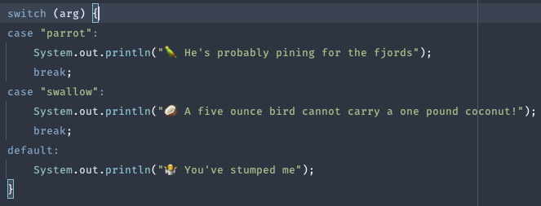
Java 7
Project Coin
Strings in switch statement

Slide 12
Java 7
Project Coin
Automatic resource management (try-with-resources)
Resource allocation as part of try
Automatically closed right before any catch or finally
Anything that implements java.lang.AutoClosable

Slide 13
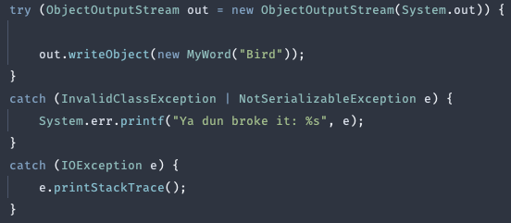
Java 7
Project Coin
Automatic resource management (try-with-resources)

Slide 14
Java 7
Project Coin
Catch multiple exception types (multi-catch)
Catch exceptions of multiple types in the same block
Exception types do not have to be “compatible”
Other rules for catching exceptions still apply (e.g. catch specific before generic)

Slide 15

Java 7
Project Coin
Catch multiple exception types (multi-catch)

Slide 16
Java 7
Project Coin
Generic type inference (diamond operator)
Type of generics on RHS inferred from types on LHS
Automatically closed right before any catch or finally
Anything that implements java.lang.AutoClosable

Slide 17
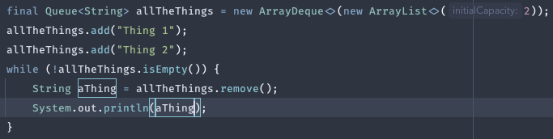
Java 7
Project Coin
Generic type inference (diamond operator)

Slide 18
Java 7
Project Coin
Numeric literal improvements
Declare binary integer literals
Use underscores in numeric literals

Slide 19

Java 7
Project Coin
Numeric literal improvements

Slide 20
Java 7
Other Changes
NIO file library
Multiple file systems
First class support for file paths
File metadata
Symbolic links
SPI for expanding file system support
Fork/join framework
Dynamic language support through invokedynamic

Slide 21
Java 8

Slide 22
Java 8
Enhancements in a nutshell
Lambdas
Functional programming
Default methods
Streams
Proper date/time API
Annotation enhancements
Remove the Permanent Generation (a.k.a. “permgen”)

Slide 23
Java 8
Lambdas
First serious foray into functional programming
Replacement for anonymous inner classes in many cases
Inherit the scope of the caller
“Shape” of methods become important
Functional interfaces – single abstract method (SAM)
Defines method and constructor references
Also includes default methods on interfaces
Notes:
Lambdas were probably the most important enhancement to Java since generics in Java 1.5

Slide 24
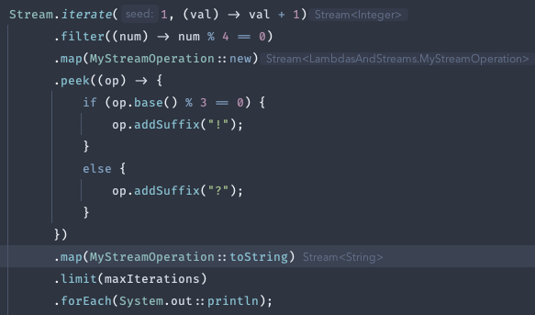
Java 8
Lambdas
First serious foray into functional programming

Slide 25
Java 8
Lambdas
First serious foray into functional programming
Simple expression, no semicolon, return implied

Slide 26
Java 8
Lambdas
First serious foray into functional programming
Multi-statement lambda (no return here, but an explicit return statement would be used if the method signature required a return value)

Slide 27
Java 8
Lambdas
First serious foray into functional programming
Constructor reference
Method references
Notes:
There are 4 kinds of method references: constructor, static method, instance method of a type, instance method of a specific object.

Slide 28
Java 8
Lambdas
Default methods
Allows for interface evolution
Defines behavior on an interface
Provides a limited mechanism for multiple inheritance
Allows interfaces with multiple methods to be “functional”

Slide 29
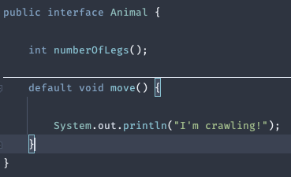
Java 8
Lambdas
Default methods

Slide 30
Java 8
Lambdas
Streams
Functional
Efficient processing of collections
Allows parallelization without changing pipeline
Immutable – each modification produces a new stream
“Intermediate” & “terminal” operations

Slide 31
Java 8
Lambdas
Streams

Slide 32
Java 8
Lambdas
Streams
Stream creation

Slide 33
Java 8
Lambdas
Streams
Intermediate operations

Slide 34
Java 8
Lambdas
Streams
Terminal operation

Slide 35
Let’s Demo!
Lambdas, Streams, Optionals

Slide 36
Java 8
Date/Time API
Simple and robust dates & times (JSR-310)
java.time package and sub-packages
Fluent and consistent API
Immutable types
Unit enums (months, days of week, etc.)
First-class support for comparisons, math, formatting
Machine-scale & human-scale time
Chronologies (calendar systems)
Notes:
The API strives to be simple, but date & time handling is a complex topic. Be sure to read the JavaDocs to learn which classes are appropriate for a given situation.

Slide 37
Java 8
Date/Time API
Instants
Fixed point in the stream of time, basically a timestamp
Closest analog to java.util.Date

Slide 38
Java 8
Date/Time API
Periods & Durations
Amounts of time
Period: human-scale
Duration: machine-scale

Slide 39
Java 8
Date/Time API
Local Dates & Times
Date, time, or combination, with no time zone or offset
Should be the “default” choice for internal date/time
Notes:
Time zones & offsets add significant complexity. They should be reserved for the “edges” of a system, such as for display to a user. Internal logic should stick to local dates & times (or instants) if at all possible.

Slide 40
Java 8
Date/Time API
Zoned/Offset Dates & Times
Adds a time zone or offset to a date/time
Offset… uses a fixed offset from UTC
Zoned… has a variable offset due to factors like DST

Slide 41
Java 8
Date/Time API
Formatting
java.time.format package
More flexible than java.text.DateFormat
Both parsing and printing
Built-in facilities for standard and localized formats
Pattern-based formatting, similar to DateFormat, but more options
Builder to provide fine-grained, programmatic control

Slide 42
Let’s Demo!
Date/Time API

Slide 43
Java 8
Date/Time API
Resources
“Philosophical” overview: https://jcp.org/aboutJava/communityprocess/pfd/jsr310/JSR-310-guide.html
Homepage of the project, including a bolt-on “extras” package: https://www.threeten.org/ | https://www.threeten.org/threeten-extra/
Package JavaDoc (Java 15 edition): https://docs.oracle.com/en/java/javase/15/docs/api/java.base/java/time/package-summary.html

Slide 44
Java 8
Annotations
Repeating
Simplifies applying multiple annotations of the same type
Still requires defining a “container” annotation

Slide 45
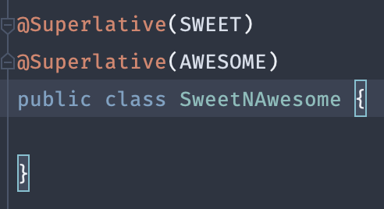
Java 8
Annotations
Repeating

Slide 46
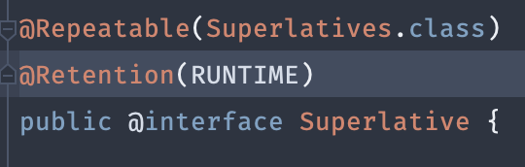
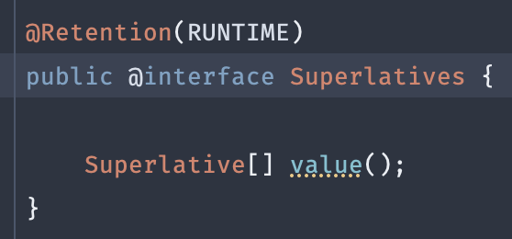
Java 8
Annotations
Repeating

Slide 47
Java 8
Annotations
Type Annotations
Expands the locations that annotations are allowed
Annotations can be applied anywhere that a type is used
Instance creation
Type casting
Throws clauses
Etc.
https://www.oracle.com/technical-resources/articles/java/ma14-architect-annotations.html

Slide 48
Java 8
Permgen
Remove the “permanent generation”
Permgen was the area of the heap where class metadata was stored
Eliminates the -XX:PermSize and -XX:MaxPermSize JVM options
Reduces the dreaded java.lang.OutOfMemoryError

Slide 49
Java 8
Permgen
Replaced with “Metaspace”
No longer part of the heap
Grows automatically
Tuned with new JVM flags
MetaspaceSize
MaxMetaspaceSize
MinMetaspaceFreeRatio
MaxMetaspaceFreeRatio

Slide 50
Epilogue
To summarize, in conclusion, wrapping up…

Slide 51
Epilogue
6-month release cycle
Use an OpenJDK distribution, rather than an Oracle one
Use the features of “Project Coin”, like the diamond operator, resource management, and multi-catch
Get familiar with the new filesystem APIs
Learn how to lambda
Use the new date/time API instead of the old java.util classes
Don’t tweak your permgen

Slide 52


Q & A

